Slide 1
Healios – our offering for Early Intervention services
Jan 2016

Slide 2
Agenda
The Healios philosophy
Therapy areas and product offerings
Your goals and challenges
Healios delivered outcomes
Discussion

Slide 3
The Healios philosophy
Founded with the goal of improving the lives of patients and families through delivering evidenced-based services to change unhealthy behaviours
Provides a unique online, clinician led service, by bringing together the best clinical evidence, combined with the best of technology, whilst still maintaining a human touch
Recognises the great work and care being delivered within the NHS whilst appreciating the strain the health service is under
Strives to support & optimise this great work by collaborating with NHS treatment teams to enhance the ‘triangle of care’ between the patient, family and NHS physician

Slide 4
Healios provides innovative solutions across multiple conditions with new therapy offerings in development
Mental illnesses/Neurological conditions
Physical conditions
Psychosis, Schizophrenia
Anxiety
Dementia
Adjustment disorder
Diabetes & CV
Bipolar
PTSD
COPD/Asthma*
Child & Adolescent
Depression (incl. perinatal*)
Obesity*
Substance misuse*
Eating Disorders
HIV/AIDS*
Built on components of behavioural family therapy, brief systemic family therapy & functional family therapy
Underpinned by relevant national clinical guidelines on behavioural change
* In development

Slide 5
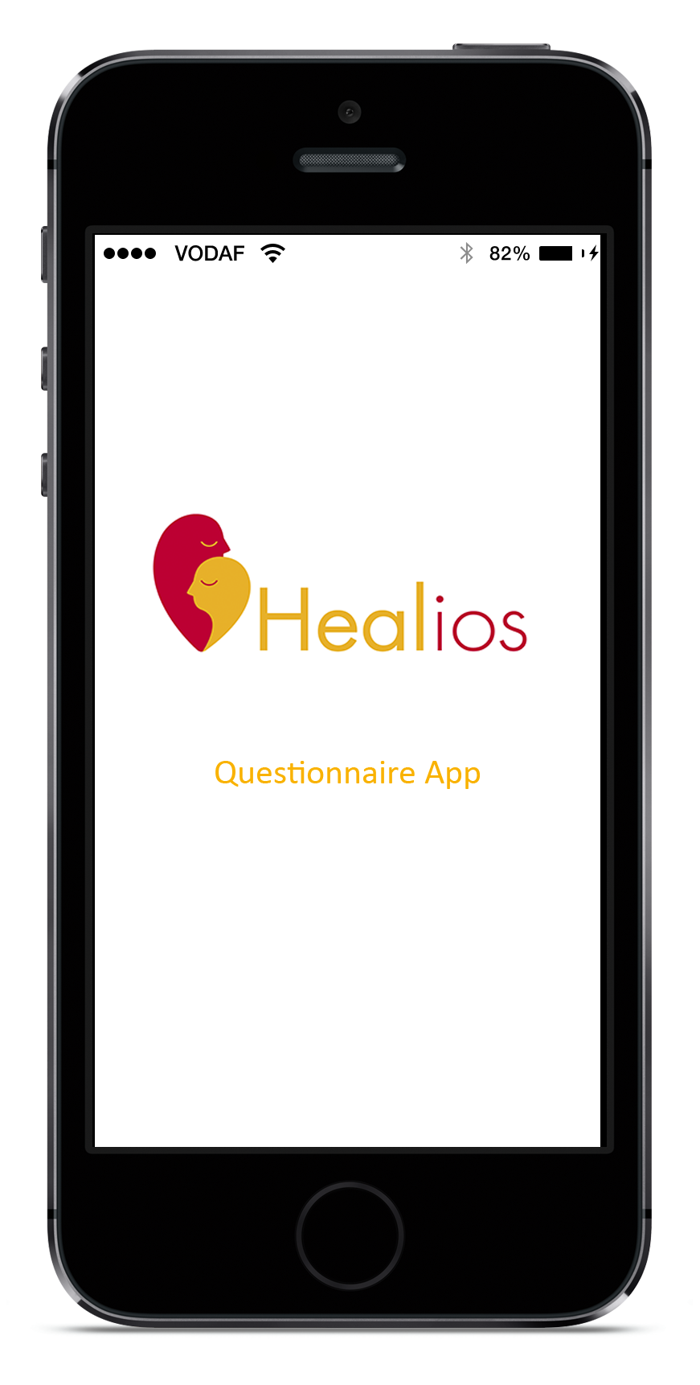
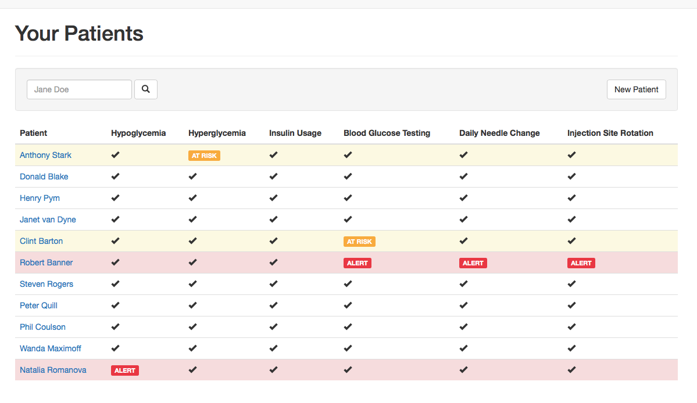
Healios provides two digital solutions, facilitating positive change and enabling early action to be taken
Healios Online Behaviour Change
The only UK online and clinician-led family intervention service built upon the Behavioural Family Therapy model to address patient and family unhealthy behaviours driving poor outcomes in psychosis
Healios Decision Tool
Patient & family
Patient health status ‘in the home’ sent by patient and/or carer via Healios app to NHS Treatment team dashboard allowing:
Early warning for change in patient status
Enables NHS team to prioritise resources
Improved clinical decisions

Slide 6
Healios is commissioned across England by CCGs, Trust, local authorities and charities to transform mental health services
An example list of areas that have commissioned Healios services

Slide 7
LIVE DEMO

Slide 8
Understanding your challenges

Slide 9
Hot topics - new EIP requirements and investment to improve patient and family care starting from April 2016
By 1 April 2016, more than 50% of people experiencing FIP, treated with a NICE approved care package within two weeks
All patients & families affected by psychosis should be offered family intervention
For early intervention crisis & acute care, offer family intervention within two weeks

Slide 10
Family involvement from the start significantly reduces mortality rates
Mortality Hazard Ratio
30%
90% reduction in unnatural causes when family involved from the start
50%
90%
Mortality by Cause
Reininghaus et al 2014: 10 year follow-up data of early intervention services in psychosis

Slide 11
Family Intervention should be prioritised within the NICE concordant care package for psychosis
Through 38 randomised clinical trials, FI has consistently proven to:
Reduce overall cost of care
Reduce relapse
Reduce hospitalisation
Reduce burden
Improve treatment adherence
Increase functionality
Many other parameters
FI impact on reducing relapse and hospitalisation
FI reduces average length of stay (days) in hospital
50% reduction
61% reduction
Bed days
% relapse & hospitalisation

Slide 12
Healios delivered outcomes

Slide 13
Healios delivers upon the family intervention requirements as outlined within the NICE clinical guidelines & quality standards
NICE clinical guidelines & quality standards state:
Healios Service
Family intervention should:
include the person with psychosis or schizophrenia if practical
be carried out for between 3 months and 1 year
include at least 10 planned sessions
take account of the whole family's preference for either single-family intervention or multi-family group intervention
take account of the relationship between the main carer and the person with psychosis or schizophrenia
have a specific supportive, educational or treatment function and include negotiated problem solving or crisis management work. [2009]
✓
✓
✓
✓
✓
✓
NICE clinical guideline CG178: Psychosis and schizophrenia in adults: treatment and management (February 2014)
NICE quality standards QS80 for family intervention (February 2015)

Slide 14
Healios improves the lives of people with mental illness and their family members
Patient-related outcomes
Family-related outcomes
Family critical comments
Substance use
Treatment adherence
Overall Family burden
Family overall distress
13% reduction
22% reduction
8% increase
28% reduction
23% reduction
Healios data from over 3,000 sessions in psychosis between Jun 2013 – Mar 2015 based on users having 8 sessions with a Healios clinician

Slide 15
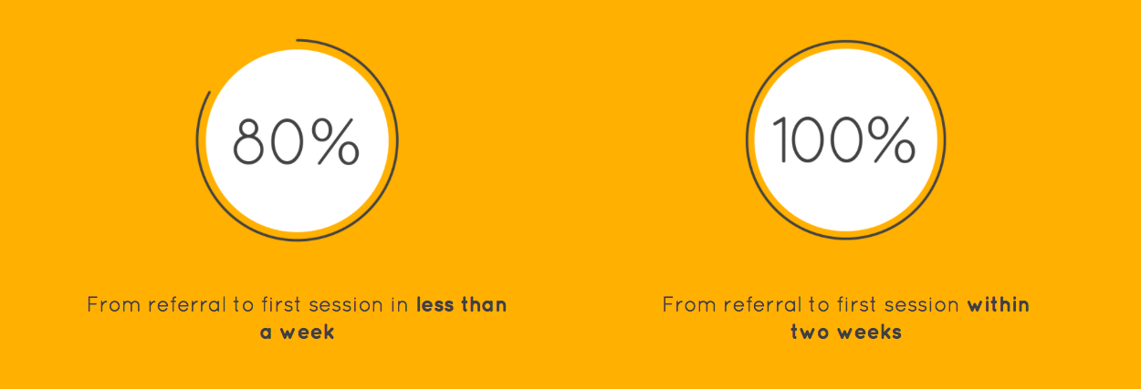
Healios makes referral to first session within 2 weeks a reality..
Our service reduces access challenges to urban and rural populations
Data based on Healios mental illness service

Slide 16
Healios: Delivering exceptional customer experience and satisfaction ratings whilst providing increased patient choice
Healios seeks feedback on service quality by using clinically validated customer satisfaction scales
Data based on Healios mental illness service

Slide 17
Commissioning Healios helps you save Time and Money to re-prioritise in other areas of need (based on 100 patients/families receiving 12 sessions of FI)
293 total days
Days of FI admin
£144,000
Days of round-trip travel time
£
Days of FI sessions
150
Current Services
Cost of Delivery
Working Days

Slide 18
How does Healios achieve these results?

Slide 19
Healios/Trust hybrid models: Supporting NHS teams
Personal Human Connection
Best of Technology
Proven Techniques
Better outcomes
Patient/family choice
Access & reach
Engagement
Satisfaction
Efficiency
Quality
Costs
Holistic Approach
Patients
Carers and families
NHS
Real time Collaboration

Slide 20
Healios has established a new gold-standard in clinical supervision to deliver a consistently high quality FI service
Recording of All Session
Ensures consistent high quality & safety
Strive for Continuous Improvement
Healios’ Manual Rating Scale (HMRS)
Continuous professional development supported with training from Consultant Psychiatrist and other psychology specialisms based on current evidence base
Clinicians self mark against consistent scale
Weekly Quality Control & Supervision Model
Overseen by Consultant Psychologist
Supervision by Clinical Team Leader
Provides regular high quality 1:1 and group supervision, training and development coaching
Recorded sessions selected each week and scored against the HMRS
Notes:
Healios provides assured quality through clinical team delivering sessions within a set framework built on evidenced based BFT model. Consistent supervision and quality checks through our 5 tier quality control approach:
1) All sessions are recorded so able to trace back if required
2) Ongoing training & development through written test & psychiatrist led teaching
3) Self reflect and review against Healios Manual Rating scale
4) Random sample of sessions marked by team leader weekly
5) Random sample of sessions marked by Head of Clinical who marks for Oxford and was part of DoH task force

Slide 21
Healios has a highly experienced clinical management team with an extensive background in NHS Early Intervention
LARS HANSSEN, MD
Medical Director
KATIE ASHCROFT, PhD
Service & Training Leader
ALISON JOYCE
Clinician Team Manager
Consultant psychiatrist with 20 years of experience
Leads an NHS Early Intervention in Psychosis (EIP) team
Published over 100 articles on mental illness
Participated in mental health programs for ITV, Channel Four, BBC radio and television
A long-term dedication to the well-being of the whole family
Previously Consultant Clinical Psychologist in an NHS EIP team
Nearly 20 years experience in mental illness
Expertise in Cognitive Behaviour Therapy, mindfulness and Family Work for Psychosis
Trained and supervised Early Intervention Service staff in family work across the Southern Health NHS Trust
Mental Health Practitioner with a range of experience in mental health and relationship interventions spanning 18 years
Worked in an NHS EIP team focusing on the delivery of Behavioural Family Therapy and previously shift leader on a Psychiatric Intensive Care Ward
Personal experience of caring for family member with psychosis and the impact of trauma
A team of highly trained clinicians, all with an extensive background in the NHS, deliver family intervention sessions supervised by a consultant clinical psychologist

Slide 22
In Summary, Healios provides a family intervention service which supports Trusts to…..
Deliver Improved Outcomes
For patients & families evidenced using validated scales across more than 6,000 session
Deliver upon the Access & Waiting Time Standards
With 100% of referral to first session within two weeks
Save Money
Healios delivers family intervention at, on average, 50% of the NHS cost
Save Time
Partnering with Healios to deliver family intervention, can free up a significant number of working days to re-prioritise in other areas of need
Deliver High Quality, Highly Engaging FI
With 98% of customers being very satisfied or satisfied and 95% of customers would definitely recommend the Healios service

Slide 23
IMPROVING LIVES INCREASING ACCESS TRANSFORMING CARE.

Slide 24
STEVE ROBERTS
Business Development Manager
Healios
Stephen.roberts@healios.org.uk
Tel: +44 (0) 797 177 0584

