Slide 1
Problem we are addressing and consequences
Copyright - All Rights Reserved C2-Ai 2019
What is the problem that your intervention addresses?
Hospitals want to demonstrably provide the highest standard of care and safety for patients.
To achieve this, they need a system that can:
accurately help them identify both avoidable mortality and harm within the hospital
assess performance that reflects the true case-mix of patients (physiology, triggers of avoidable harm, complications, risk of any surgical intervention/procedure etc.) rather than comparing simple complication/mortality rates to national averages
drill down to resolving the causes at patient level with solutions
identify omissions to act or treat in addition to existing incident reporting
provide this feedback on emerging issues quickly (within 30 days) so that the hospital can resolve the harm/mortality problem
identify subtle but significant and serious issues (e.g. single clinician issues on a handful of cases)
spot and resolve potentially runaway issues that have caused some of the scandals that have been reported in the last few years
Existing BI type systems do not provide this information as they:
only report on a 6 to 12 month delay
do not do accurate risk-adjustment at a patient level (e.g. do not consider every diagnosis for patients)
are not able to identify specific patients to support follow-up case-note investigations
do not consider avoidable harm in any detail, and critically cannot identify harm that has occurred from omissions to treat or act.
may sometimes identify major issues such as AKI but cannot say where it is happening within the hospital and provide solutions
What are the consequences?
There are significant consequences for hospitals of not using a system like ours.
Patient Harm
Hospital cannot truly understand how it is performing at hospital, specialty, team and consultant level – meaning there are significantly higher instances of lives lost , avoidable harm and readmissions than necessary
Variability in patient care (increasing treatment costs)
Some higher risk operations avoided due to potential impact on surgeon’s stats
Wasted Money
Direct opex costs to treat patients
Around £1.3m pa of clinical negligence costs per hospital
Wasted Resources
Improvement teams chasing down problems that don’t exist (false positives)
Failure to engage whole hospital staff in improvements
Beds blocked by patients that were avoidably harmed
Reputation and Governance
Cannot deliver highest standards of clinical governance
Potentially lower CQC ratings than are warranted
Cannot demonstrate performance and improvements over time
Hospitals do not have the evidence they need to defend their reputation and assist in CQC assessments
Higher complaints than necessary
(missed opportunity - outcomes / health care resource utilisation)
Notes:
GETTING YOUR VALUE PROPOSITION RIGHT IS A SESSION ON ITS OWN – It’s a way into a conversation
It is a question on the INNOVATOR ENGAGEMENT FORM that each AHSN uses to get you started. It helps AHSN staff start to think about the more common issues that they will need you to be aware of.
A Value Proposition is likely to evolve over time as the opportunities become clearer and better informed.

Slide 2
What do we do?
Copyright - All Rights Reserved C2-Ai 2019
Improving outcomes for patients - Reducing harm and the cost of care
We help hospitals reduce avoidable patient harm and mortality while demonstrably supporting corporate and clinical governance.
Hospital health check undertaken > Monthly BI + CI Reporting configured > Quality Improvement initiative implemented > 12 month review > Repeat.
Our unique approach is individualised with ‘made to measure’ results for every patient, accurately and uniquely adjusted for physiological characteristics and multiple triggers of avoidable harm. Risk of complications are patient specific and so can be used to improve care, avoid harm and demonstrably reduce associated costs.
A hospital performing higher risk surgery will see higher complication rates than those that do not. Typical BI systems will flag the first hospital because they do not consider the actual patients being treated, their physiology, the clinical acuity of their condition, and most importantly risks of the surgery itself.
Why we are different.
We risk adjust accurately for each patient and can tell which hospitals, specialties, consultants etc. are genuinely doing well, and where the hospital has issues and what the causes are.
Why existing BI systems do not deliver what we provide
We track and analyse 178 complications and harm events across all inpatient care. The majority of these are not commonly available or even possible to capture without our Ai algorithms that triangulate them from multiple sources.
Our value proposition to reduce avoidable harm to patients whilst saving the NHS trusts money:
C2-Ai conduct a business and clinical intelligence Base Line Audit of hospital trusts (please note we do not currently cover ambulance, community or mental health organisations, and we are currently installed and working closely with Frimley Health).
C2-Ai will identify areas where care can be improved, such as Acute Kidney Injury like our South Tees example, and support the trust to implement a QI initiative for improving care and saving money as identified in the bespoke hospital audit.
CRAB and Compass systems are installed for each organisation.
Each individual organisation will receive monthly business and clinical intelligence reports as well as C2-Ai support to monitor improvements across the whole organisation.
After 12 months from start up, an Annual Audit Report is produced to quantify improvements in avoidable harm to patients and calculate Harris Opex Tracker savings.
Repeat. Improve care, save money.
Built around…
25
Years of research
120m
Patient records
46
Countries providing data
11
Countries we work in
Uniquely assessing the whole organisation…
146
Surgical complications
32
Triggers of avoidable harm
100%
of patients and all their diagnoses
100%
of surgical procedures
Notes:
GETTING YOUR VALUE PROPOSITION RIGHT IS A SESSION ON ITS OWN – It’s a way into a conversation
It is a question on the INNOVATOR ENGAGEMENT FORM that each AHSN uses to get you started. It helps AHSN staff start to think about the more common issues that they will need you to be aware of.
A Value Proposition is likely to evolve over time as the opportunities become clearer and better informed.

Slide 3
What are the changes in consequences through using our systems?
Copyright - All Rights Reserved C2-Ai 2019
In 14 partner hospitals in the UK during a recent 12 month period, improvements led to 455 lives saved, nearly 4,000 harms avoided and >£20m saved
CARE BENEFITS
Lower avoidable harms
Lower avoidable mortality
Fewer readmissions
Fewer omissions to act/treat
Patients unsuitable for procedures are determined and optimized before hospital visit
More informed decision on whether to operate in hospital
Patients can provide truly informed consent
Patients get the treatment they need – even when it’s high risk!
FINANCIAL BENEFITS
Lower operating expenses due to managing and reducing costs due to treating avoidable harms
Lower clinical negligence impact (down 10%)
Lower clinical negligence legal costs
Reduction in cost per treatment and variations
Lower readmissions
EFFICIENCY BENEFITS
Lower bed blocking (reduction in avoidable delays in patient discharge)
More effective use of resources in the hospital by avoiding preventable harms
Lower management overhead wasted fixing avoidable issues and dealing with problems
REPUTATION BENEFITS
Supports demonstrable care quality and patient safety
Underpins good clinical and corporate governance
Demonstrable performance and improvement tracking of avoidable harm and mortality
Evidence to use with, and push back against, regulatory authorities potentially leading to improved ratings
Better rankings
Evidence-based clinical quality outcomes
Notes:
GETTING YOUR VALUE PROPOSITION RIGHT IS A SESSION ON ITS OWN – It’s a way into a conversation
It is a question on the INNOVATOR ENGAGEMENT FORM that each AHSN uses to get you started. It helps AHSN staff start to think about the more common issues that they will need you to be aware of.
A Value Proposition is likely to evolve over time as the opportunities become clearer and better informed.

Slide 4
What does that mean for the decision maker (buyer) and patients?
Copyright - All Rights Reserved C2-Ai 2019
Complaints/negligence are reduced and hospital teams and patients are happy. Don’t take our word for it….
“CRAB just makes sense. It presents data in a way that is easy to understand and interpret. It has been immensely useful for me both personally in my appraisal and in my role as a Clinical Director. It helps me to pick up early warning of problems with intelligence that can be believed and acted upon”
Jeremy Cundall,
Executive Medical Director - Consultant Colorectal and General Surgeon, CDDFT
"C2-Ai have the most robust software approach to comparing safety and quality across hospitals, systems and physicians that I have ever seen. The algorithms are backed up by years of published international research. I believe their approach could be most useful as a solution for providers across any network”.
James Bonnette, MD (USA)
Executive Vice President, the Advisory Board
“CRAB has allowed real time review of data, which has raised awareness and led to change in both clinical practice and hospital culture. I think it will become an essential part of the appraisal and governance structures of secondary care.”
David Williams, Consultant Surgeon
Northern Devon Hospital Trust, UK
“CRAB® is generating trusted data which we can use to flag up areas of concern. From there we are able to take action in a much more sophisticated way than we have in the past.”
Dr. Timothy Ho, Medical Director
Frimley Health NHS Foundation Trust, UK
“The problem with [HSMR systems] is that they tell you there might be a problem, but not where or why. CRAB® tells you exactly what and where the problem is, and even which patients are involved. Then you can do something about it.”
Dr. Aresh Anwar, Medical Director
Royal Perth Hospital, Australia
“CRAB® is 100% better than any solution available to us at the moment. It has turned out to be a very useful tool in analysing and understanding our case-mix and where our complications are occurring.”
Per Svedmark MD, PhD, Senior Consultant, Stockholm Spine Centre, Sweden
“We are thrilled to receive this award, which reflects a great deal of hard work and support from within and […] the support of C2-Ai who enabled us to benchmark our Trust’s Acute Kidney Injury rates against national levels - and then measure the significant impact of our AKI Programme, which coincided with a significant and sustained fall in AKI rates our Trust, especially across surgical wards”. Dr Jonathan Murray, Renal Consultant at South Tees Hospitals NHS Foundation Trust, UK
"CRAB® predictions have proved accurate in my primary external research validation of the system. I currently don’t know of any other electronic system in use that can deliver this kind of overall and detailed qualitative feedback to the department and the individual surgeon. It has been a great benefit for our clinic and helped develop our work on patient safety.”
Wilhelmina Ekström, MD, PhD, Senior Consultant, Karolinska University Hospital, Sweden
“Accurate benchmarking of outcomes was a real challenge […] however our work with [C2-Ai] has provided invaluable quality assurance. The risk adjusted reporting has provided confidence that our outcomes are better than comparable organisations and the level of detail enables us to focus on improvements in specific areas. It was particularly useful during our regulatory inspection and follow up meetings with the CQC to show how this strengthens our clinical governance…”
Dr Jenny Davidson, Director of Governance, King Edward VII’s Hospital.
Further references and success stories found here:
https://c2-ai.net/what-we-do/references/
https://c2-ai.net/success-stories/
Notes:
GETTING YOUR VALUE PROPOSITION RIGHT IS A SESSION ON ITS OWN – It’s a way into a conversation
It is a question on the INNOVATOR ENGAGEMENT FORM that each AHSN uses to get you started. It helps AHSN staff start to think about the more common issues that they will need you to be aware of.
A Value Proposition is likely to evolve over time as the opportunities become clearer and better informed.

Slide 5
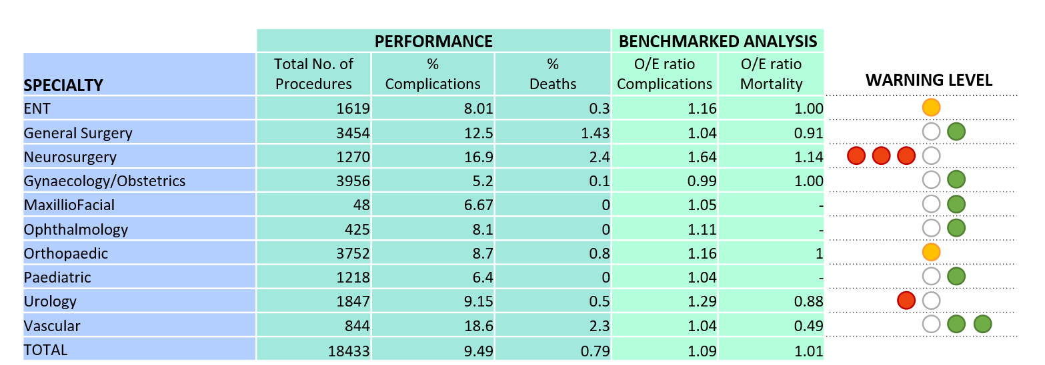
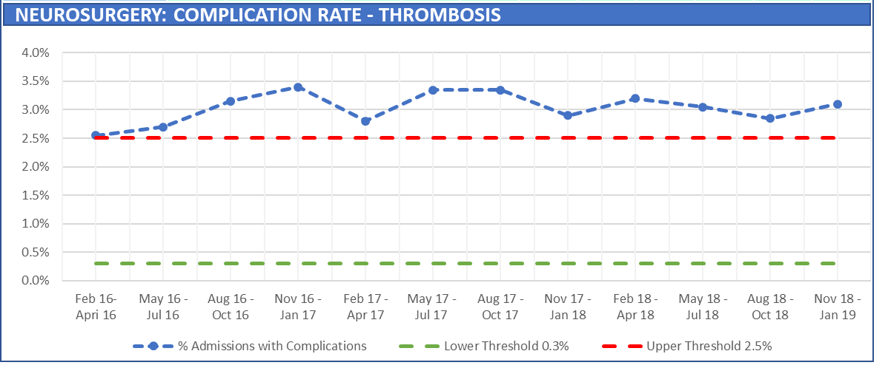
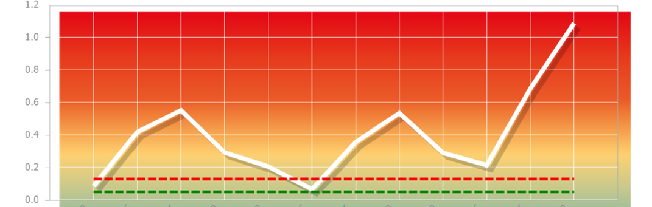
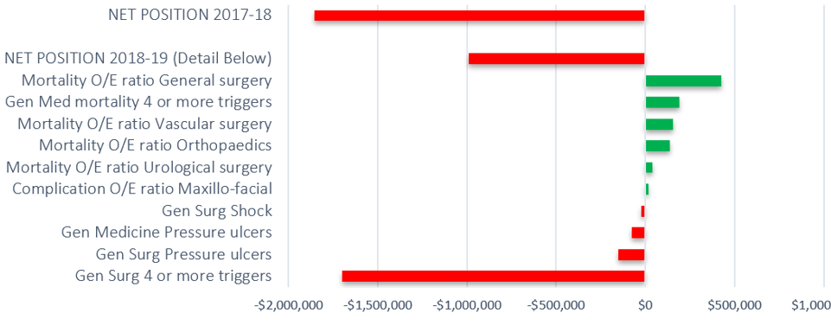
CRABTM delivers invaluable, risk adjusted outcomes reporting Our monthly and annual reports to boards/clinicians to track progress and highlight issues
Copyright - All Rights Reserved C2-Ai 2019
Harm and Mortality
Future Savings (Next 12m)
Care Efficiency Savings (12m)
2
206
35
£1.2m
£2m
Deaths
Morbidity
Lives Saved
Lives saved through improvements and harm/deaths that were avoidable (12 months)
Cost savings identified and located - where avoidable harm (risk-adjusted) should be improved
Savings made in the hospital relating to care efficiencies compared to previous year
Identification of Issues by Specialty
Drill Down by Consultant
Drill Down by Complication
Provides high-level indication and detail on harm and mortality issues this month in the hospital
Supports investigation by providing detail on type of issue, performance in previous months trends to date etc.
Support in highlighting risk-adjusted areas of concern and where they are happening in the hospital
Highlighting Issues with Harm
Tracking Opex Relating to Quality
Expert System
Stacks Overflow
Brilliant Support
Provides trend of 32 triggers of avoidable harm – highlighting emerging problems in last month
Opex Tracker identifies variable cost savings and enables you to target and monitor quality improvements
Fully flexible system allowing interrogation of results by period, specialty, consultant, operation type, trigger of harm, complication etc.
Notes:
GETTING YOUR VALUE PROPOSITION RIGHT IS A SESSION ON ITS OWN – It’s a way into a conversation
It is a question on the INNOVATOR ENGAGEMENT FORM that each AHSN uses to get you started. It helps AHSN staff start to think about the more common issues that they will need you to be aware of.
A Value Proposition is likely to evolve over time as the opportunities become clearer and better informed.

Slide 6
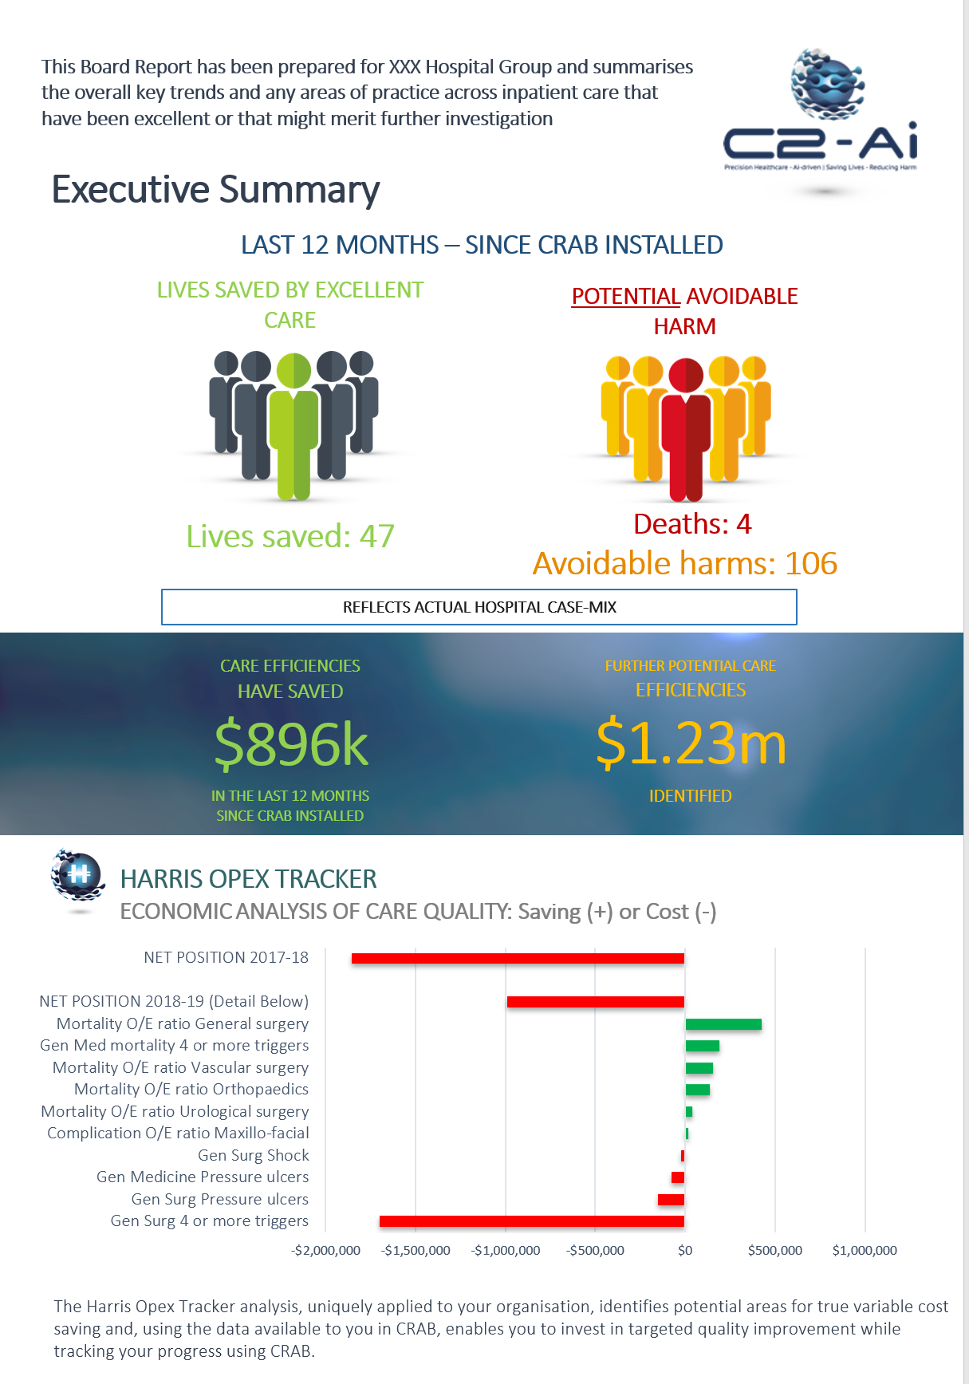
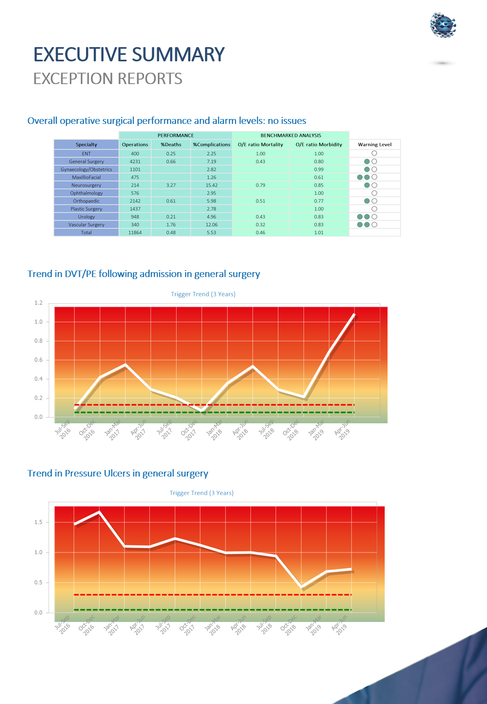
CRABTM delivers invaluable, risk adjusted outcomes reporting Example annual report
Copyright - All Rights Reserved C2-Ai 2019
Notes:
GETTING YOUR VALUE PROPOSITION RIGHT IS A SESSION ON ITS OWN – It’s a way into a conversation
It is a question on the INNOVATOR ENGAGEMENT FORM that each AHSN uses to get you started. It helps AHSN staff start to think about the more common issues that they will need you to be aware of.
A Value Proposition is likely to evolve over time as the opportunities become clearer and better informed.

Slide 7
Hospitals need to understand why and how they are different, where there are issues and identify how to fix them We complement existing management tools -
Copyright - All Rights Reserved C2-Ai 2019
APPROACH TO IDENTIFYING ISSUES IN HOSPITALS |  | Typical Systems
Results based on statistical averages from broader patient population | x | ✓
Analyses results for all patients based on individual physiology, full clinical history and proposed treatments | ✓ | x
Risk-adjusted harm as well as mortality | ✓ | x
Reliable clinical application at patient level across surgical, medical and nursing care | ✓ | x
Accurately predicts outcomes, benchmarked internationally against objective referential data | ✓ | x
Supports investigation of avoidable mortality and harm down to individual patients - for all patients | ✓ | x
Delay between discharge and results - hence delay to starting resolution of problems highlighted | 1 month | 6 – 12 months
Further USP found here: https://c2-ai.net/faq/
Notes:
GETTING YOUR VALUE PROPOSITION RIGHT IS A SESSION ON ITS OWN – It’s a way into a conversation
It is a question on the INNOVATOR ENGAGEMENT FORM that each AHSN uses to get you started. It helps AHSN staff start to think about the more common issues that they will need you to be aware of.
A Value Proposition is likely to evolve over time as the opportunities become clearer and better informed.

Slide 8
Scale of the problem
Copyright - All Rights Reserved C2-Ai 2019
‘In 2013/14, 1.4 million patient safety incidents were reported to the NHS.
Around 1.3 million of these were categorised as ‘low harm’ or ‘no harm’; 49,000 incidents resulted in ‘moderate harm’; 4,500 in ‘severe harm’; and there were 338 ‘never events’.
Half of all patient safety incidents are thought to be avoidable.
However these numbers are likely to be an underestimate due to the well-recognised issue of underreporting.”
https://www.hee.nhs.uk/sites/default/files/documents/Improving%20safety%20through%20education%20and%20training.pdf
HEE – UK 2016
‘a typical facility could save up to $29 million annually by delivering care in line with cost benchmarks for high-quality hospitals’
https://www.marketscreener.com/news/High-Quality-Hospitals-Deliver-Lower-Cost-Care-82-of-the-Time--27363041/
Advisory Board – US 2018
‘if all hospitals lifted their performance to match best 10%, an extra 250,000 patients would go home complication-free – saving about £800 million every year’
https://grattan.edu.au/report/safer-care-saves-money/
Grattan Institute - Australia
Our systems are very sensitive, such that for one of the USA’s largest chains - one that already has a reputation for instilling an aviation-level safety culture - we could still tell them which were the 6 surgeons (in 1,000 doctors) who on a risk-adjusted basis had outlying practice for low-level but recurring complications.
We also identified a range of ward-based harm issues, less than 13% of which had been captured by their routine monitoring and incident reporting.
The result is that we give visibility on problems that no one else can find, but also pinpoint their origins and provide the solutions. And we give international validation for the good performers. So this is not about policing, it is about improving quality, driving reputation and saving money.
Reducing the risk of patient harm during the process of healthcare delivery is at the forefront of policy and practice.
Preventable patient harm affects nearly one out of 20 patients in health care services.
https://www.gmc-uk.org/-/media/documents/preventable-patient-harm-across-health-care-services_pdf-73538295.pdf
A report for the General Medical Council - July 2017
Notes:
GETTING YOUR VALUE PROPOSITION RIGHT IS A SESSION ON ITS OWN – It’s a way into a conversation
It is a question on the INNOVATOR ENGAGEMENT FORM that each AHSN uses to get you started. It helps AHSN staff start to think about the more common issues that they will need you to be aware of.
A Value Proposition is likely to evolve over time as the opportunities become clearer and better informed.

Slide 9
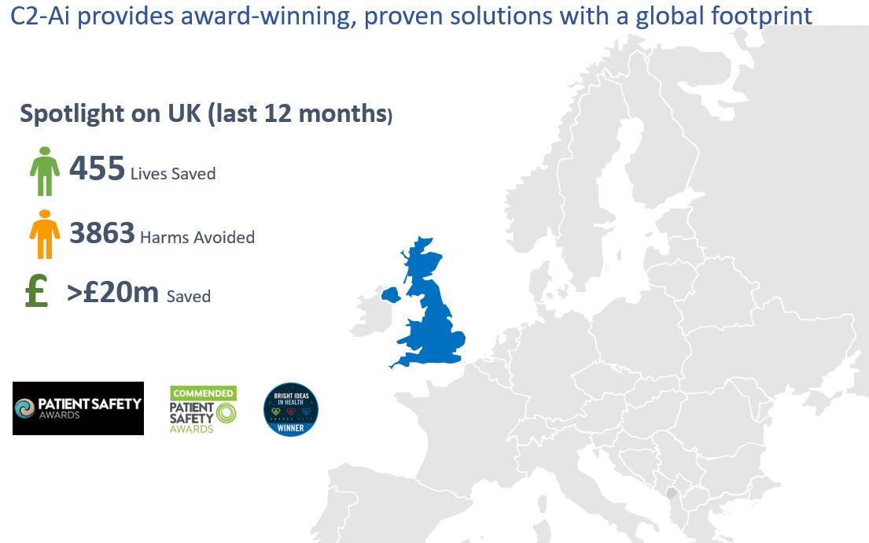
Copyright - All Rights Reserved C2-Ai 2019
The link between quality and cost has historically been difficult to prove. We have done it.
Harris Opex Tracker - linking care quality and cost
Applying the Harris Opex Tracker analysis to an organisation helps:
Pinpoint the services costing money due to poor quality
Identify and focus on the biggest cost area for maximum results the professionals who deliver it.
Understand what the quality shortfalls are and how to correct them, so improvements can be made rapidly
Chart the financial impact of service changes
Identify where higher quality services are creating savings to share cost-effective models of care able to show it anecdotally.
Benchmark an organisation internationally
Hospitals and finance directors under pressure to make savings the clear choice is to cut services and staff, but this can place them in direct conflict with the founding principles of healthcare and the professionals who deliver it.
Our ground-breaking model built around our core algorithms and analytical engine is called the Harris Unit.
It creates a sophisticated but accessible ‘profit and loss’ to show on a single page the economic impact (positive and negative) of the quality of care across a hospital.
455 lives saved in our partner hospitals
To give a view on how effective our systems are, we looked at a recent 12-month period in our partner hospitals in the UK alone. Improvements made in that period can be equated to saving of 455 lives, nearly 4,000 instances of harm avoided and more than £20m in the direct costs associated with treating those harms.
Avoidable costs and therefore (in)efficiency can be identified - for example:
complaints and litigation;
increased length of stay due to hospital acquired problems;
avoidable use of HDU/ITU; and
return to theatre/unnecessary surgery and equipment usage
Notes:
GETTING YOUR VALUE PROPOSITION RIGHT IS A SESSION ON ITS OWN – It’s a way into a conversation
It is a question on the INNOVATOR ENGAGEMENT FORM that each AHSN uses to get you started. It helps AHSN staff start to think about the more common issues that they will need you to be aware of.
A Value Proposition is likely to evolve over time as the opportunities become clearer and better informed.

Slide 10
Copyright - All Rights Reserved C2-Ai 2019

Slide 11
Copyright - All Rights Reserved C2-Ai 2019

Slide 12
Copyright - All Rights Reserved C2-Ai 2019

Slide 13
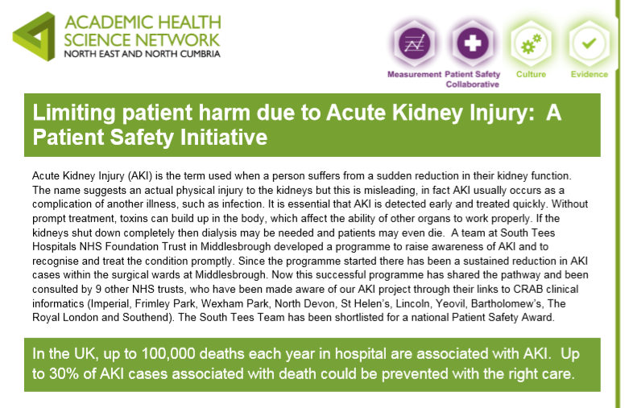
Example of the benefits of the work carried out so far. AKI Case Study – South Tees NHS Foundation Trust, written up by North East and North Cumbria AHSN. *Original Document provided
Copyright - All Rights Reserved C2-Ai 2019
Notes:
GETTING YOUR VALUE PROPOSITION RIGHT IS A SESSION ON ITS OWN – It’s a way into a conversation
It is a question on the INNOVATOR ENGAGEMENT FORM that each AHSN uses to get you started. It helps AHSN staff start to think about the more common issues that they will need you to be aware of.
A Value Proposition is likely to evolve over time as the opportunities become clearer and better informed.

Slide 14
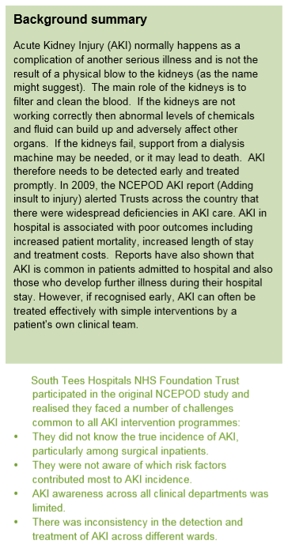
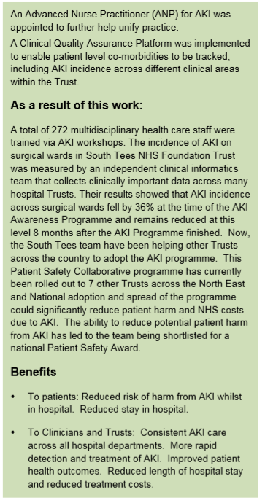
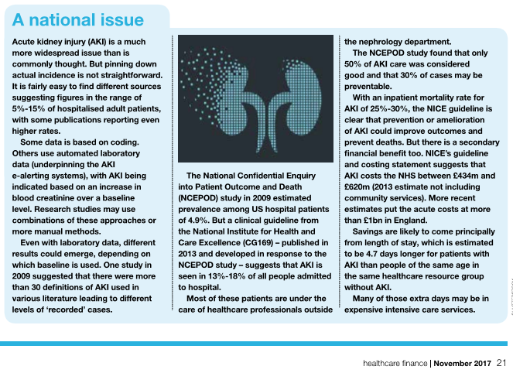
Copyright - All Rights Reserved C2-Ai 2019
South Tees AKI study continued.
In addition to the reduction in patient harm, South Tees NHS Foundation Trust estimates the AKI programme has saved the Trust £533,000 per year.
Also published in Healthcare Finance Magazine. (*article provided)
The NCEPOD study indicated that’s 30% of AKI cases could be preventable.
NICE estimates AKI costs the NHS £1bn a year.
Notes:
GETTING YOUR VALUE PROPOSITION RIGHT IS A SESSION ON ITS OWN – It’s a way into a conversation
It is a question on the INNOVATOR ENGAGEMENT FORM that each AHSN uses to get you started. It helps AHSN staff start to think about the more common issues that they will need you to be aware of.
A Value Proposition is likely to evolve over time as the opportunities become clearer and better informed.

Slide 15
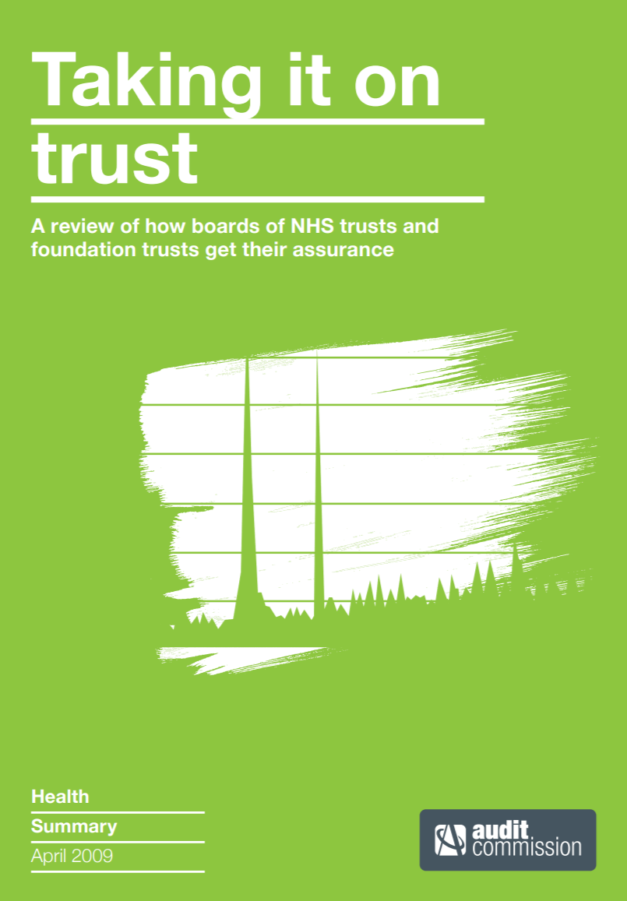
Copyright - All Rights Reserved C2-Ai 2019
We help hospital boards/managers meet their statutory duties in the face of increasing board and personal risk of liability
“CEOs and Boards will be held increasingly responsible for harm and death caused by error¹.”
NHS Board Principles for Good Governance stress:
‘..evidence-based decision making’
‘..board has a statutory duty of quality’
‘Boards required to endorse and sign off declarations of assurance to regulators in relation to quality’
Agency for Healthcare Research and Quality states a culture of safety needs:
‘systems in place to enable staff to learn from errors …and prevent recurrence
1
“Taking it on Trust” - Audit Commission asks:
“What controls do we [the board/management team] have to ensure that the quality of data used for decision making is good enough?”
Notes:
GETTING YOUR VALUE PROPOSITION RIGHT IS A SESSION ON ITS OWN – It’s a way into a conversation
It is a question on the INNOVATOR ENGAGEMENT FORM that each AHSN uses to get you started. It helps AHSN staff start to think about the more common issues that they will need you to be aware of.
A Value Proposition is likely to evolve over time as the opportunities become clearer and better informed.

